Slide 1

Game Success Prediction
Submitted by:
Or Maymon
David Shmidt

Slide 2
Intro
It is always hard to know whether a game is a good one or not.
We wanted to determine what is the best way to predict if a game will be successful.

Slide 3

Main Process
Step 1
Step 2
Step 3
Step 4
Defining a Research Question
Data Acquisition
Data Handling
Data Analysis and Machine Learning

Slide 4

Steps Breakdown
1
Scrapping – The data was taken from a website called “vgchartz” , where we could find various data about large collection of games. We used “beautifulsoup” to extract the data.
2
We Cleaned Data from NaN values. Changed values into numerical values to better represent numbers(for example the letter “m” to 1,000,000 and so on).

Slide 5
Steps Breakdown
3
Visual representation in the form of graphs of different data about the game that will help us to predict the success of the games.
For example, a graph that represents the sales of each gaming console.
4
For the machine learning we used the logistic- regression. Logistic regression is used to describe data and to explain the relationship between one dependent binary variable and one or more nominal variable.

Slide 6
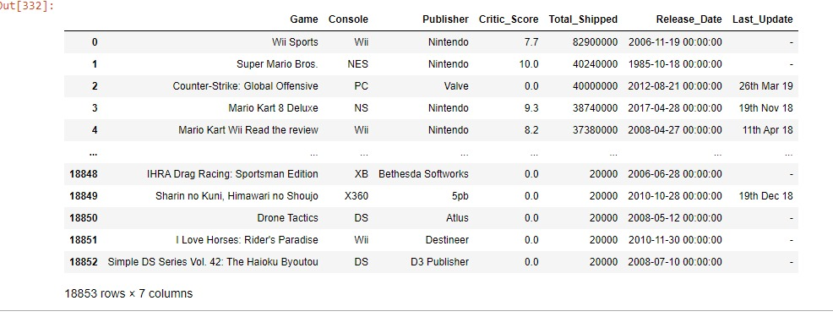
Data Frame
There are 7 columns: Game(name of the game) , Console(console you can play the game on) , Publisher(who published the game)
, Critic_Score(critics score for the game) , Total_Shipped(how many copies were sold) , Release_Date(game release date) ,
Last_Update(when was the last update of the game , in case of “ – “ there wan none).

Slide 7
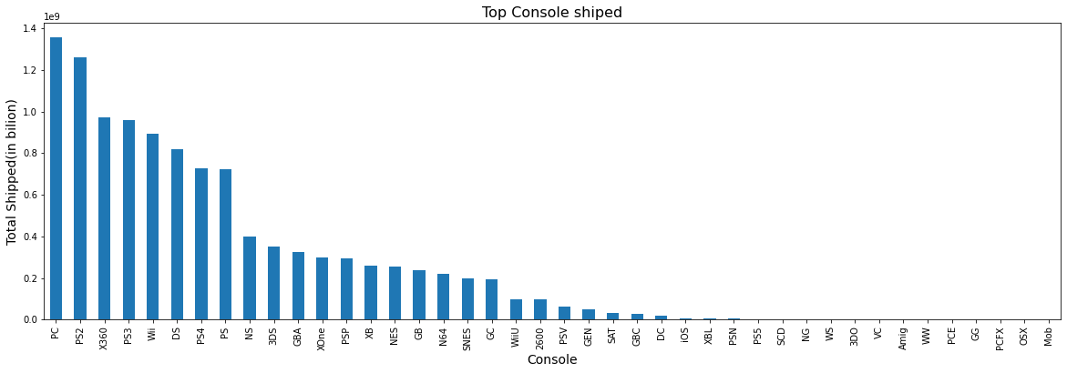
Data Visualization

Slide 8
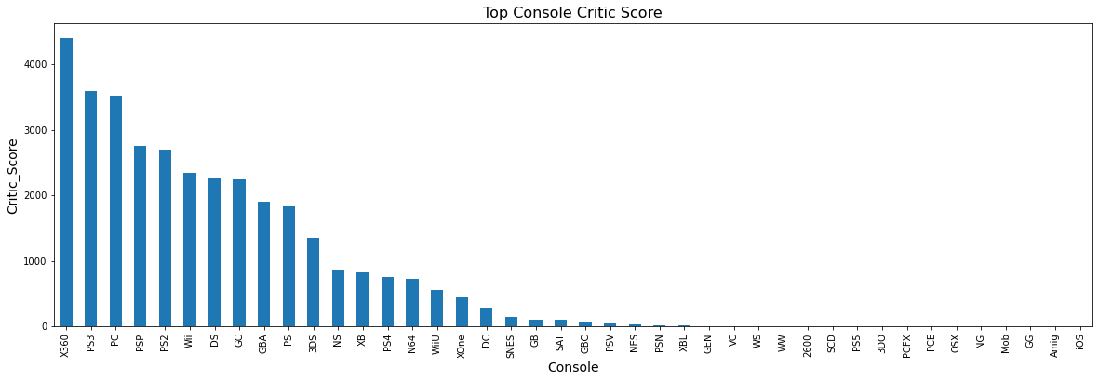
Data Visualization

Slide 9
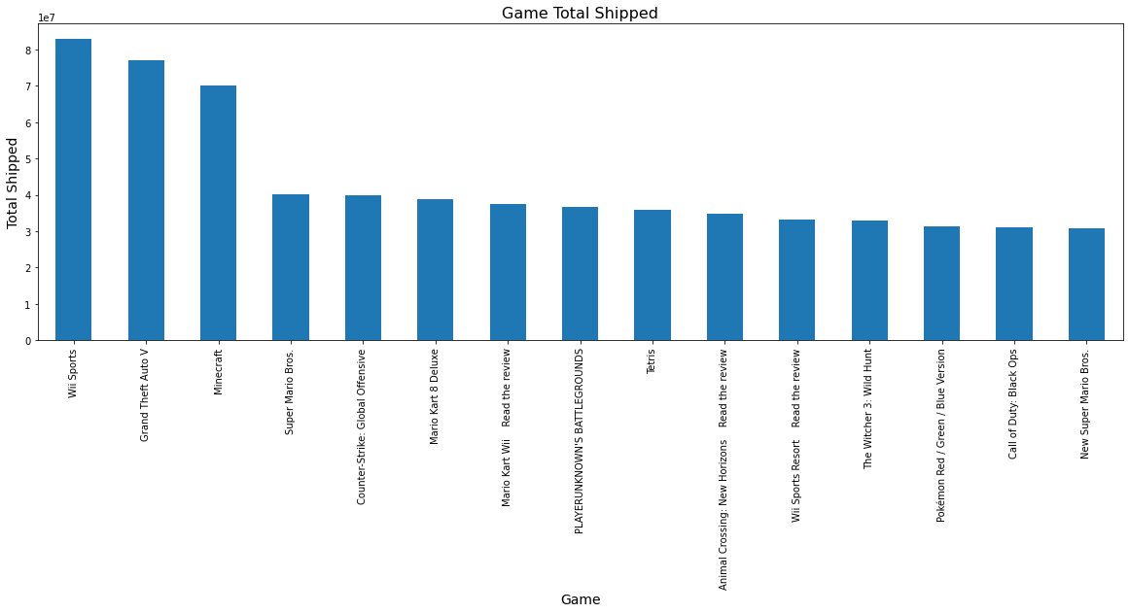
Data Visualization

Slide 10
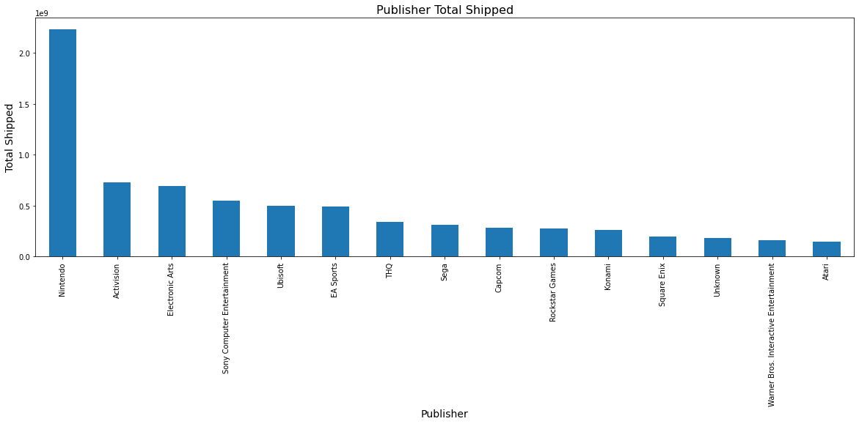
Data Visualization

Slide 11
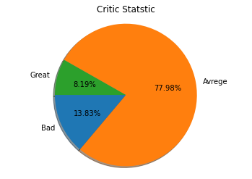
Data Visualization

Slide 12
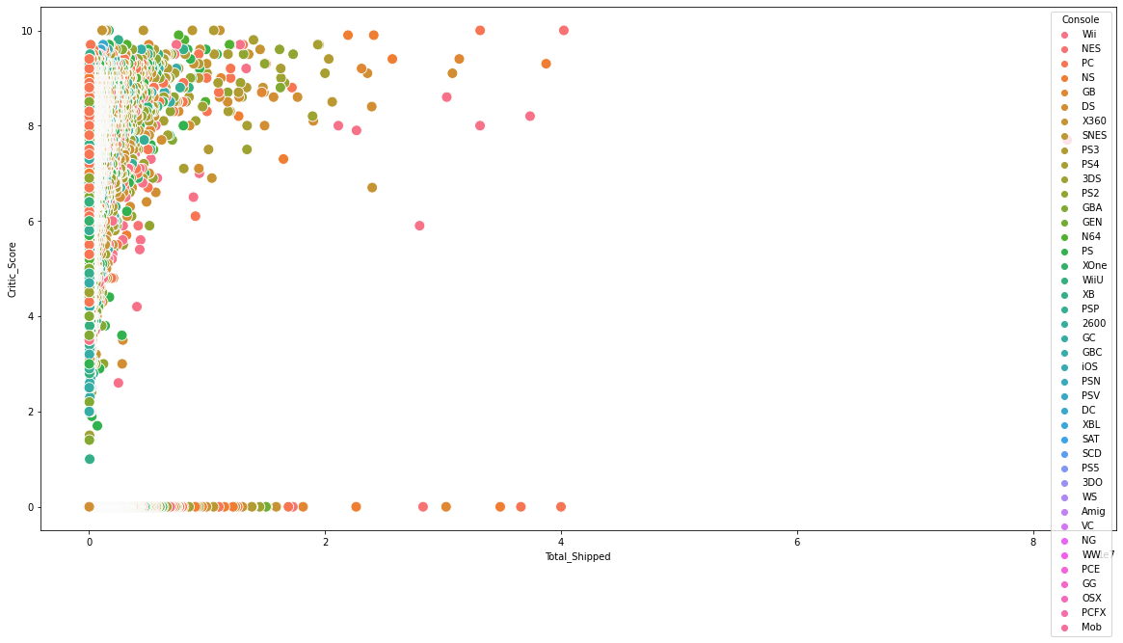
Data Visualization

Slide 13
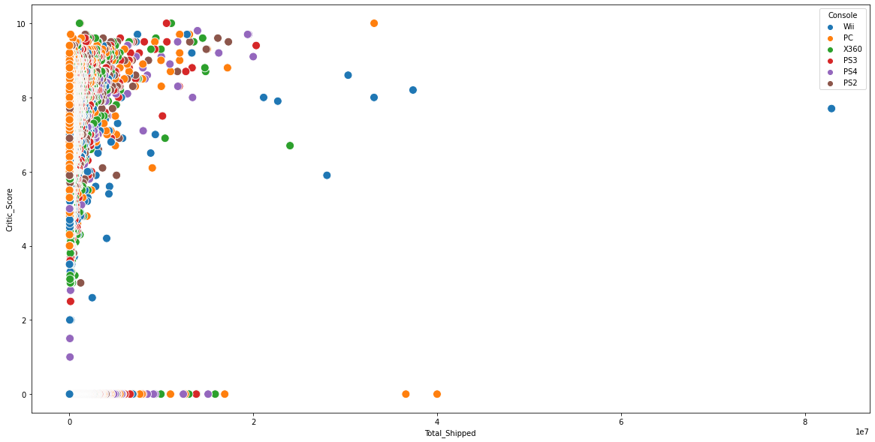
Data Visualization

Slide 14
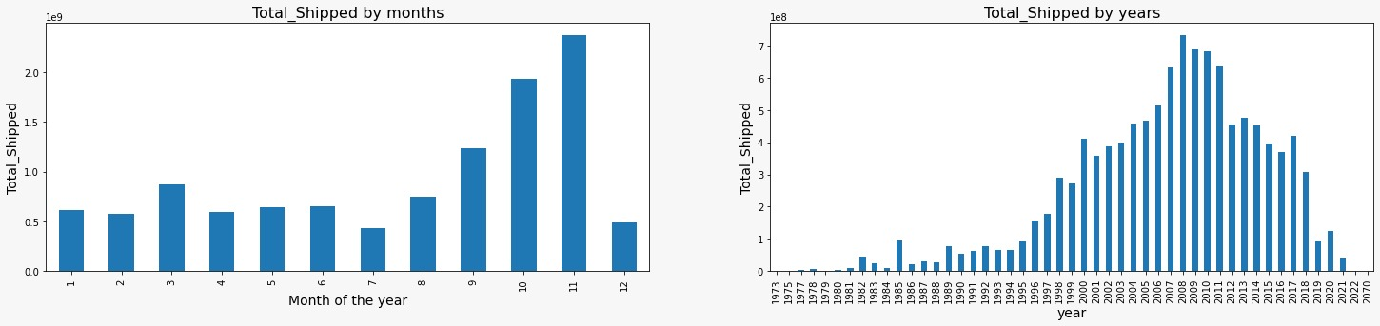
Data Visualization

Slide 15
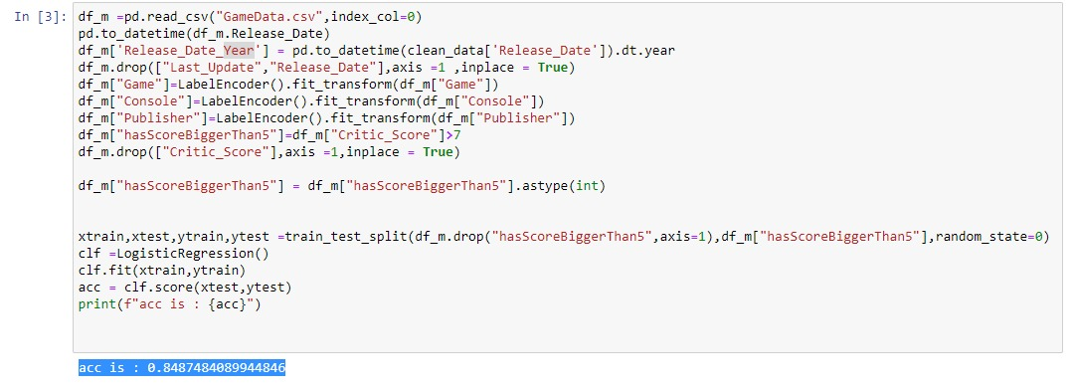
Logistic Regression

Slide 16
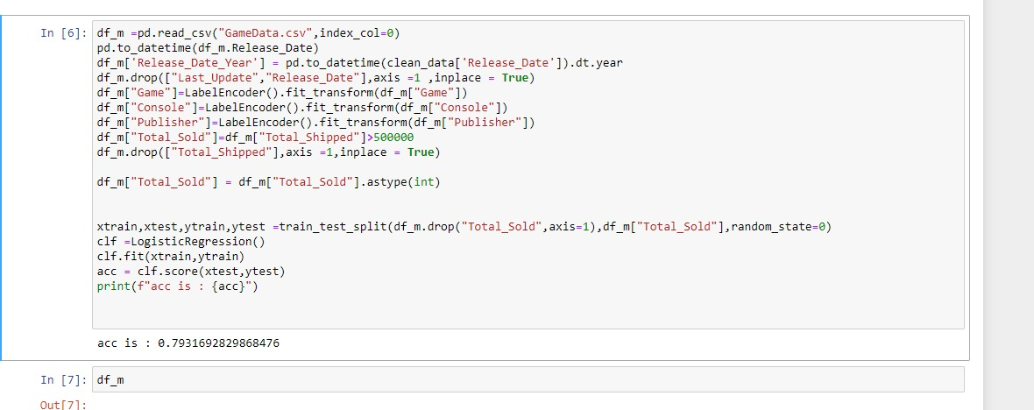
Logistic Regression

